Slide 1
Zuyd University of Applied Sciences School of Nursing Report CM Plymouth, 2020
Bastienne de Rooij, M-ANP, B.Ed, RN
Bastienne.derooij@zuyd.nl

Slide 2
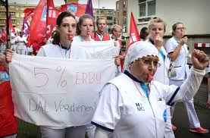
Current issues & evolutions in Nursing in my country
Bachelor of Nursing BN2020- Nursing profile EQF 6
care and guidance in your own home / environment
Transition from illness and care to health and behavior
Self-management and self-reliance
Strikes hospital nurses

Slide 3
Overview of our nursing curriculum
10 weeks 10 weeks 10 weeks 10 weeks
Year 1
Module 1 Prevention
Pl: 1 weeks
Module 2 Community care
Pl: 4 hours/week
Module 3
Low complex care
Pl: 4 weeks
Module 4 Highcomplex care
PL: 4 weeks
Year 2
Start M5-6 or Start M7-8
Module 5 Prevention
Module 6 Community care
Module 7
Low complex care
Module 8
High complex care
PL: M5 & M6 13 weeks
Pl: M7 & M8 13 wks
Year 3
Module 9 Integration module
PL: 12 weeks
*Minor/ optional education/ elective
Year 4
*Graduate
Nursing Case study/ capstone
Pl: 18 weeks
Graduate
Nursing research report
Pl: 18 weeks
Pl= placement
* Minor or Graduate Nursing Case study

Slide 4
Current issues and evolutions in our nursing education
Refinement of the new curriculum
After 2 1/2 years all nursing skills are tested
More placement hours
Modules in the second year are better suited to the internship
Community care Module 5&6
Hospital care Module 7&8)

Slide 5
Current research projects at my university
Healthcare and Well-being
Autonomy and Participation for Persons with a Chronic Illness | Sandra Beurskens
Midwifery Science | Raymond de Vries
Assistive Technology in Health Care | Ramon Daniëls
Nutrition, Lifestyle and Exercise | Susy Braun
Zuyd's research centres https://www.zuyd.nl/en/research/researchcentres
https://www.zuydnet.nl/binaries/content/assets/zuyd-intranet/en/about-zuyd/organization/zuyd-research-centres-2017-overview.pdf

Slide 6
Possibilities & wishes for cooperation in new research & educational projects
Community Care the role of the Bachelor nurse
Elderly phichiatric care
Evidence Based Practice in Nursing
Palliative Care & health promotion
Care technology
Theater room/ surgical nursing/ anestatic nursing/IC
Assesment
Oncology

Slide 7
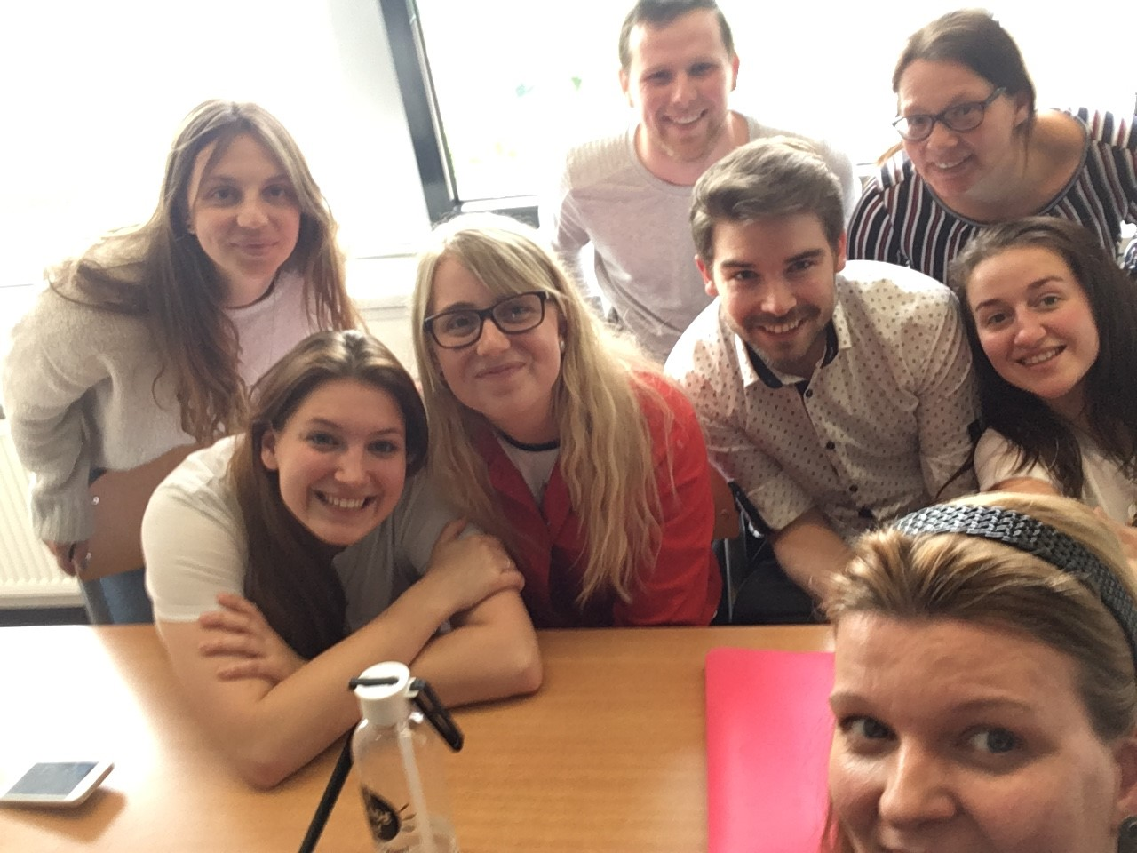
Possibilities for incoming students
Spring
Start second Monday of Februari
Autumn
Start first Monday of September
1 day school Nursing Case study Capstone in English group with incoming and NL students (Erasmus+ candidates)
3 days internship in Hospital or rehabilitation care Heerlen

Slide 8
2020
Curriculum?
Assesment formative (internships)

